Slide 1
Team Members ASVK Vinayak Sourav Bera Siddhant jaiswal
Gymstructor

Slide 2
Purpose of Gypstructor
During the COVID-19 Pandemic we can see that gyms, yoga centers are closed and we can see how difficult is to manage.
So we have came up with Gymstructor an android app from which users can do excersies, yoga in comfort of their home.
It also helps user by telling users about proper health diet, calculates user’s BMI and tells health status of the user.

Slide 3
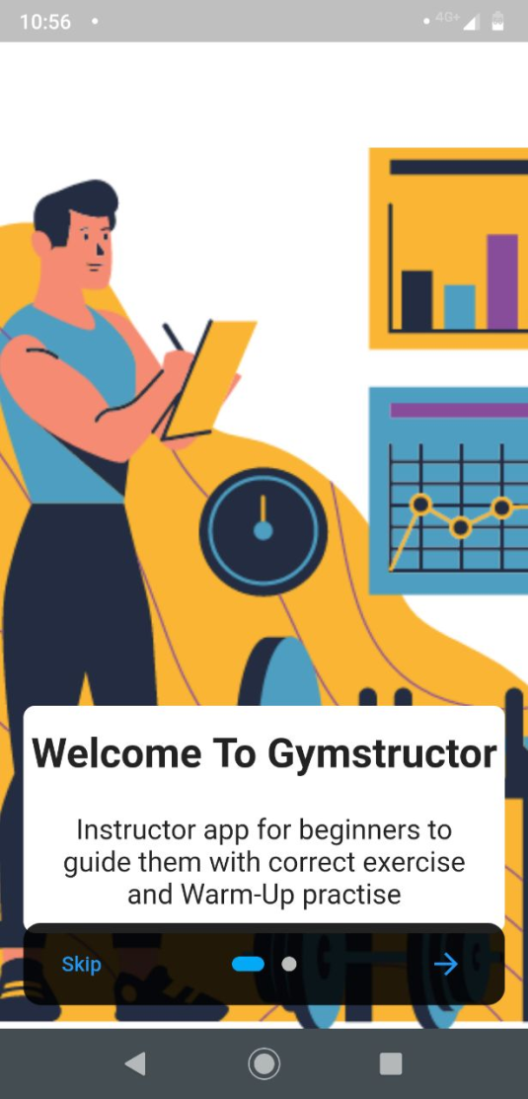
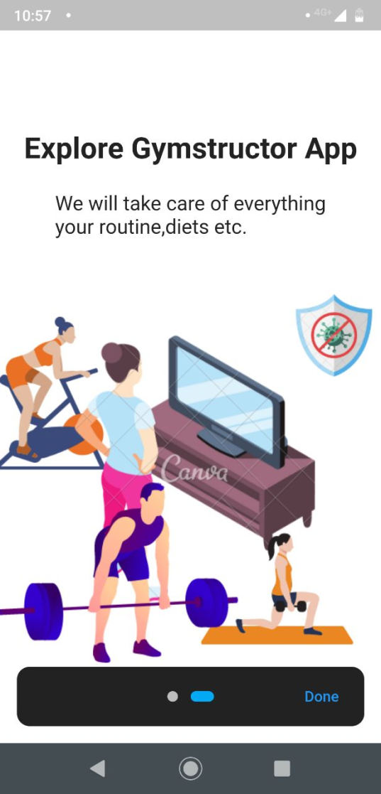
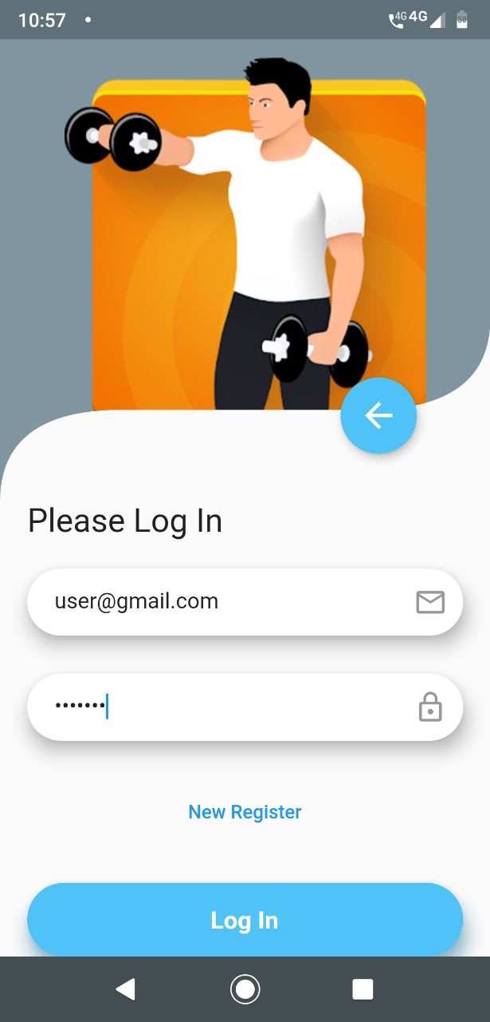
Screen shots

Slide 4
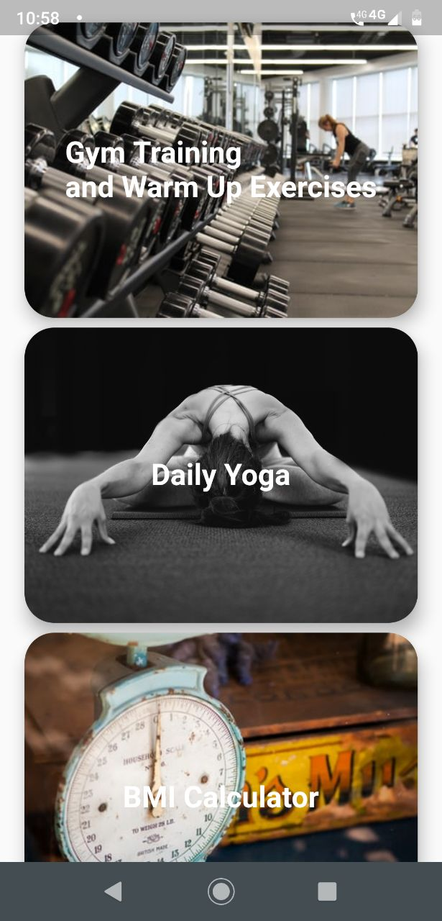
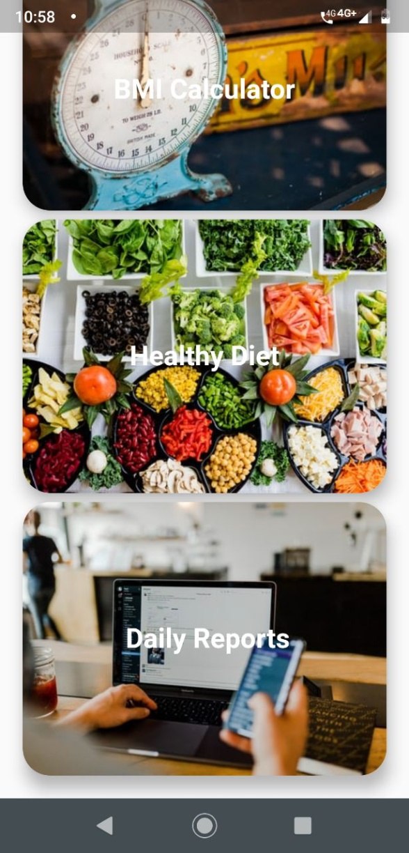
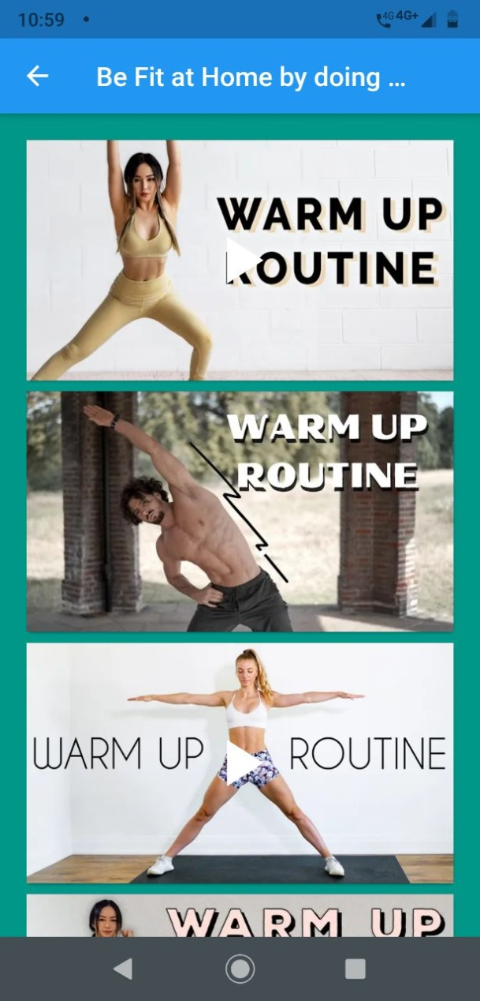
Screen shots

Slide 5
Purpose of Gypstructor
During the COVID-19 Pandemic we can see that gyms, yoga centers are closed and we can feel how difficult is to manage.
So we have came up with Gymstructor an android app from which users can do exercises, yoga in comfort of their home.
It also helps user by telling users about proper health diet, calculates user’s BMI and tells health status of the user.

Slide 6
What users can expect
We are constantly working on making the app more user friendly.
We will enhance the app by making a call section in which users can video contact their gym instructors from home only.

Slide 7
Thank You

